Slide 1
Welcome to the Windows IoT world
Harold Pulcher
pulcher@pulcher.biz

Slide 2
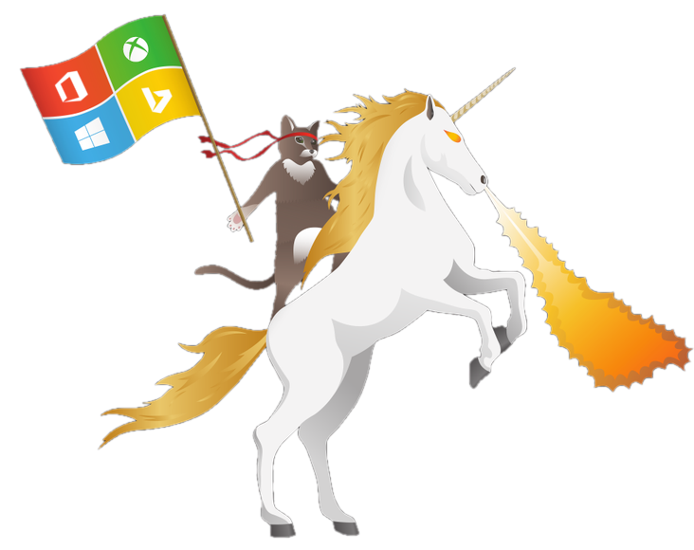
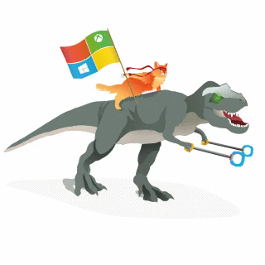
Become a Windows Insider!
https://insider.windows.com/

Slide 3

Internet of Things
20 billion devices
Metcalf’s Law
Development is easy
Hardware is cheap

Slide 4
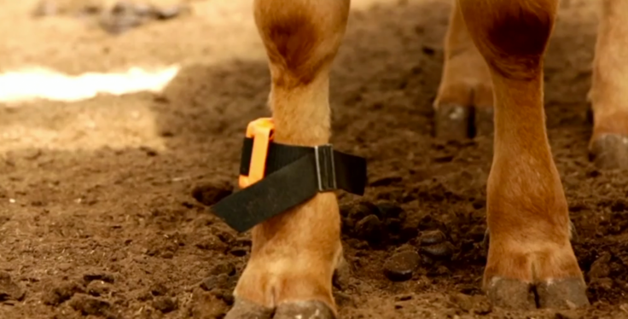
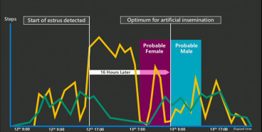
Connected Cow
http://www.youtube.com/embed/oY0mxwySaSo?autoplay=1

Slide 5
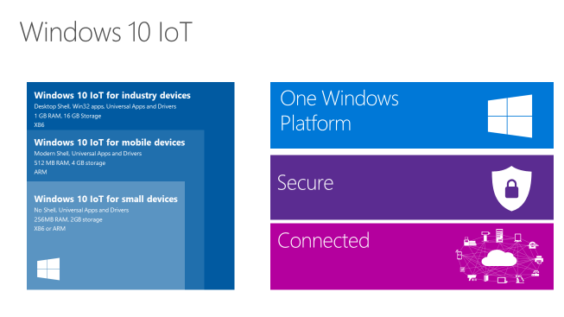
Window 10 IoT core

Slide 6

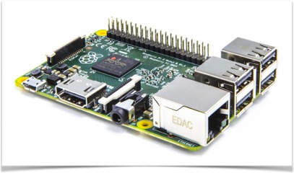
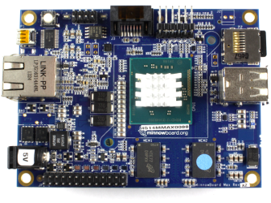

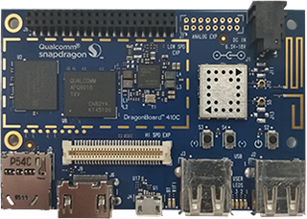
Devices
MinnowBoard Max
http://www.minnowboard.org
Raspberry Pi 2
http://www.raspberrypi.org
DragonBoard 410c
https://developer.qualcomm.com/
(RSN)

Slide 7

All of this stuff is on the edge. It is not ready for production. Don’t go building life sustaining gadgets with stuff (yet)!

Slide 8
What do you need?
Windows 10
Visual Studio 2015
http://ms-iot.github.io/content/en-US/GetStarted.htm
Raspberry Pi 2
5V micro USB power supply
8GB(min) class 10 micro SD card <- spend money on a good one!
HDMI cable
Enternet Cable
USB Mouse and Keyboard

Slide 9
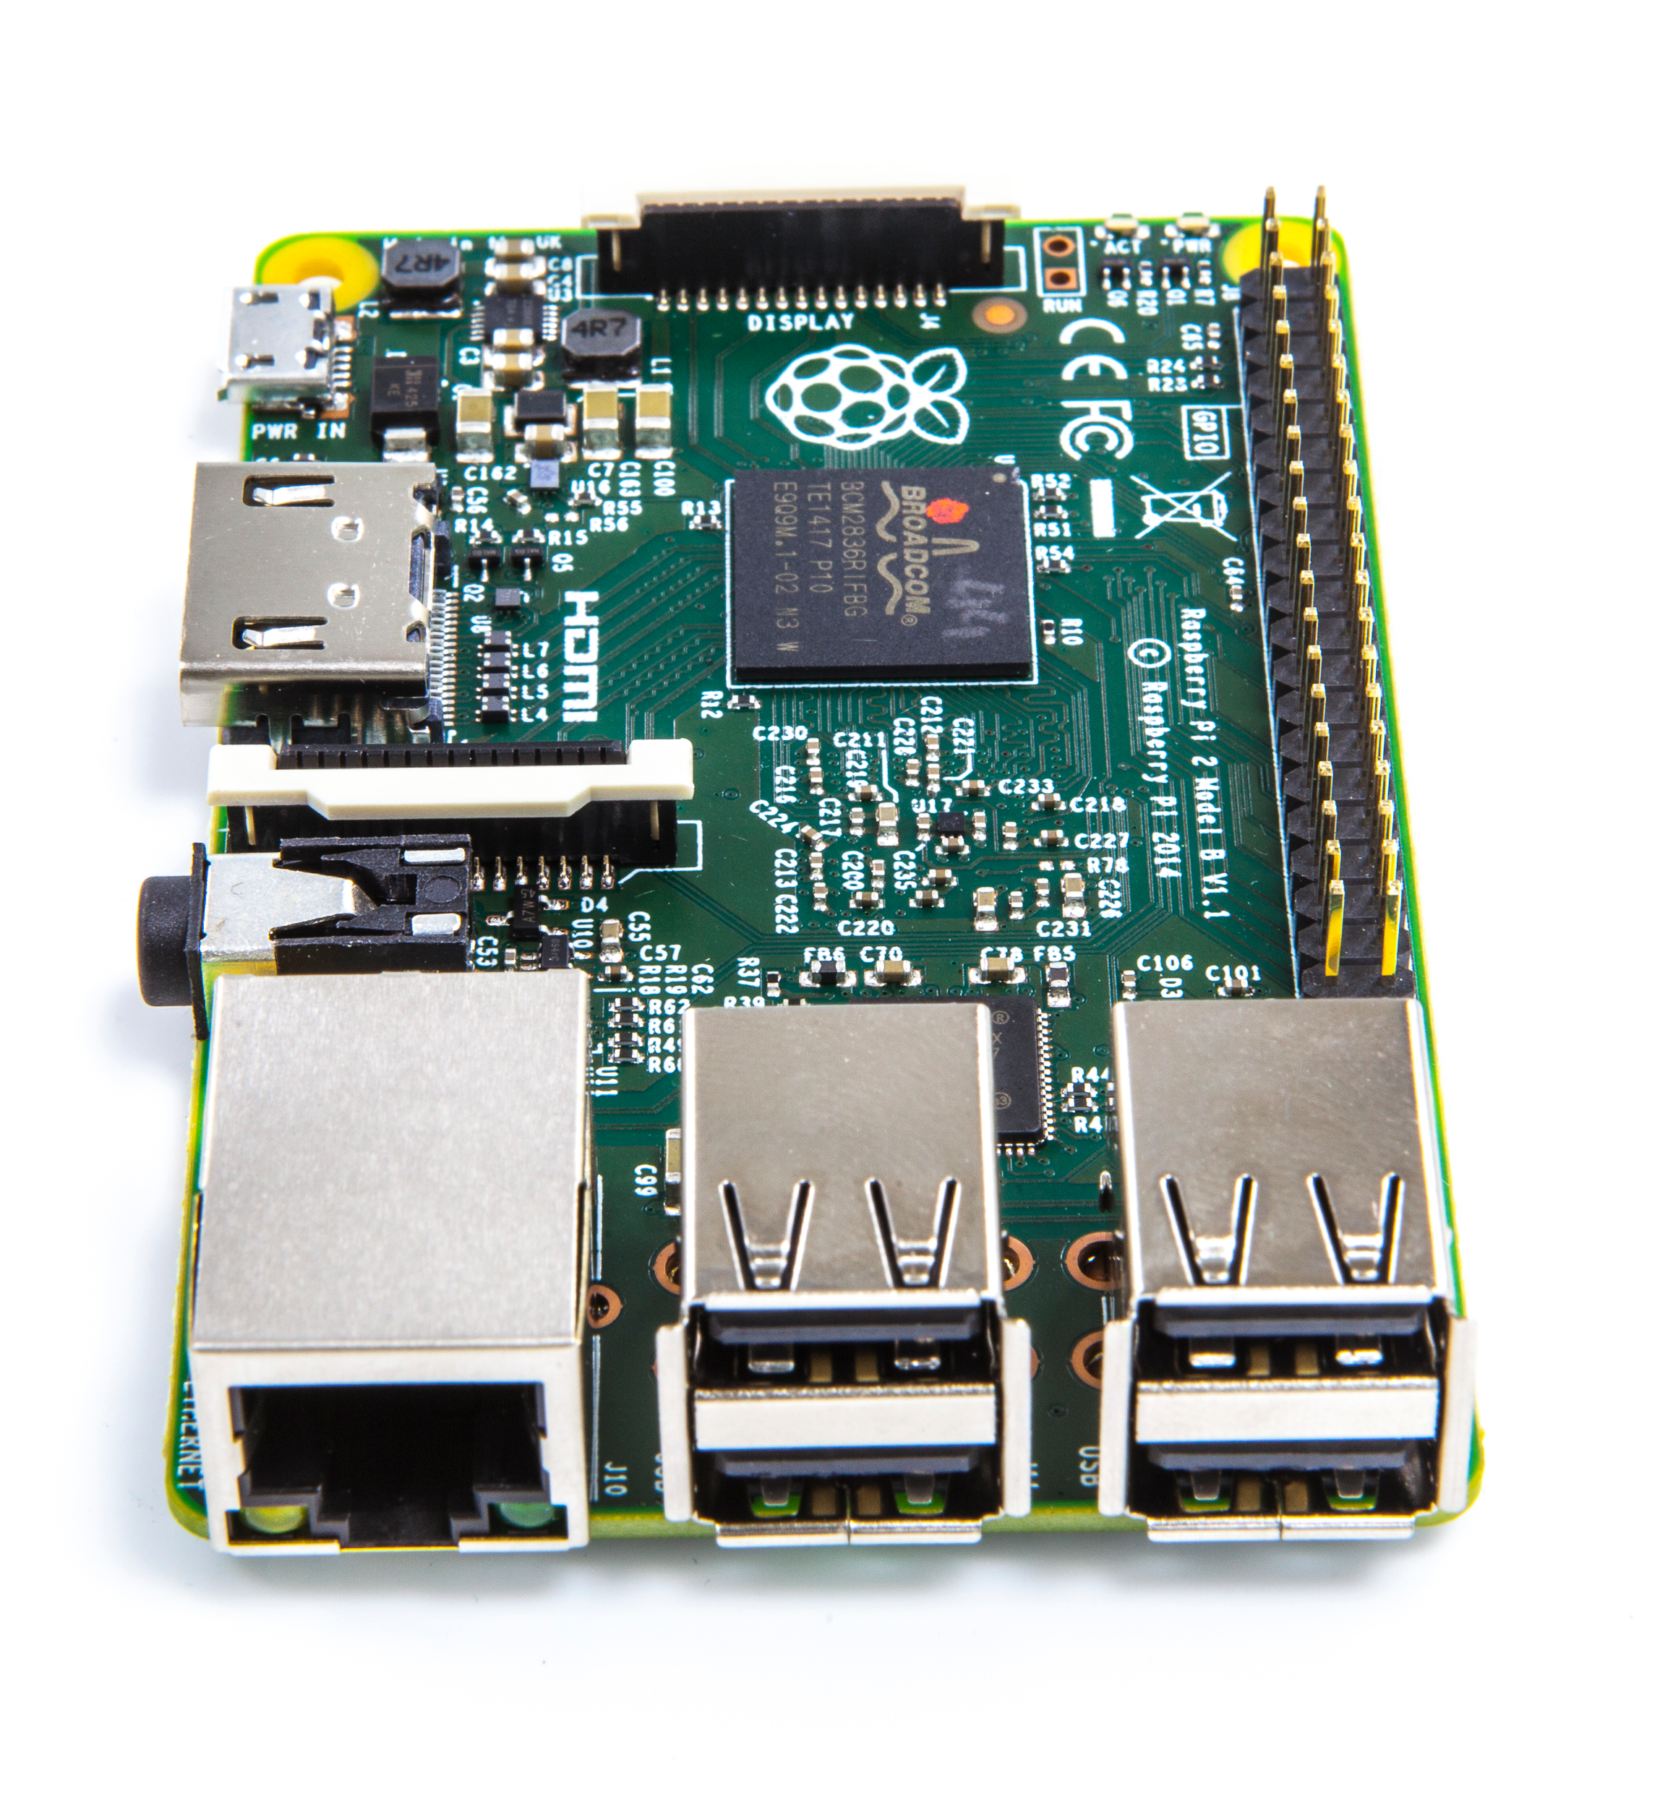
Raspberry Pi 2
900 MHz Quad Core ArmV7 processor
1GB Ram
4 USB ports
HDMI
GPU
GPIO
SPI
Ethernet

Slide 10
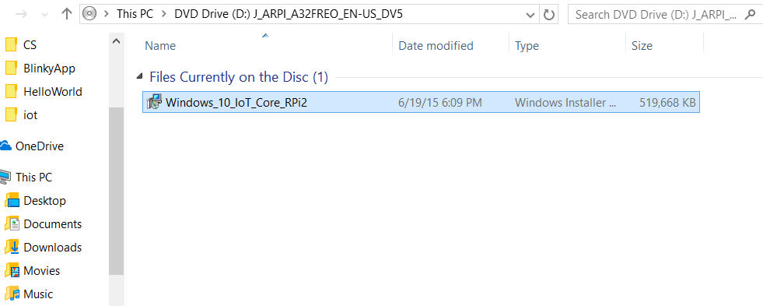
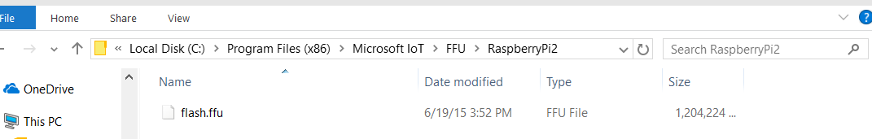
Enough already! How do I do this!

Slide 11
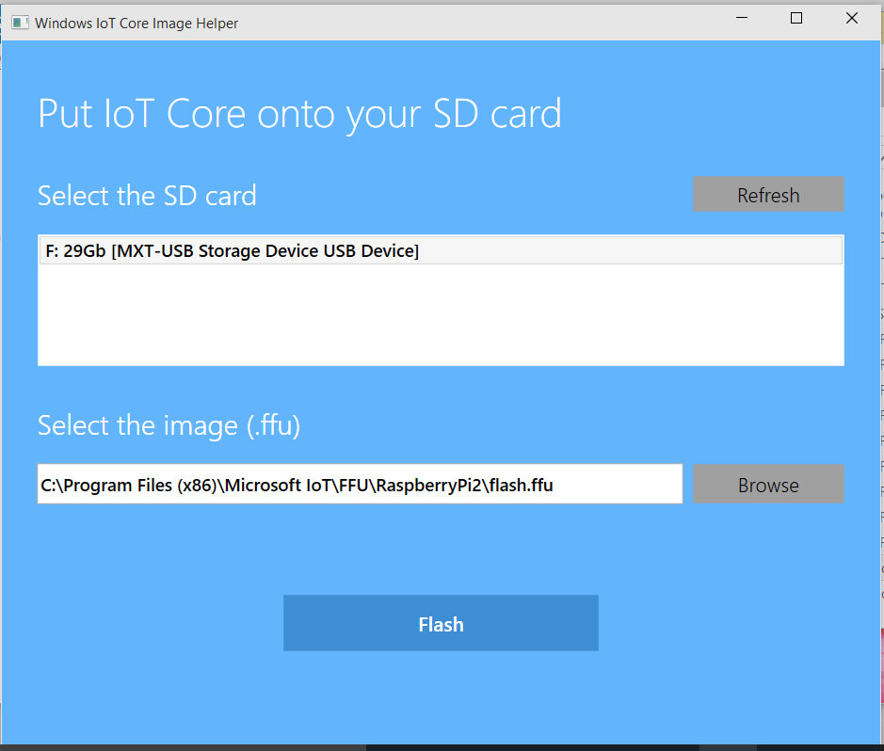

Slide 12
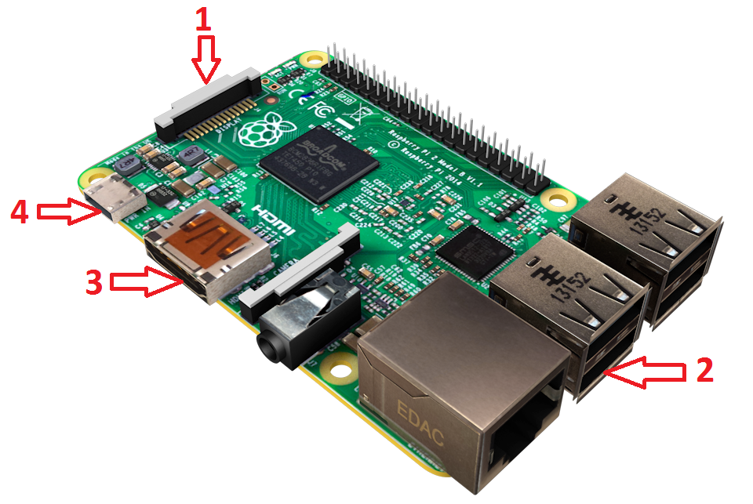
hook up the board

Slide 13
If everything goes right…..

Slide 14
The Bad News :(
Ethernet and RASPBERRY PI USB WIFI DONGLE is supported.
Lots of Universal APIs are not functional

Slide 15
The Good News!
Tons of stuff works!

Slide 16
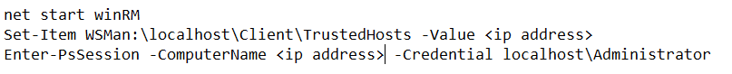
So how do we talk to this thing?
http://<ip address>:8080
PowerShell <- in admin mode
ssh <- almost any flavor
ftp

Slide 17
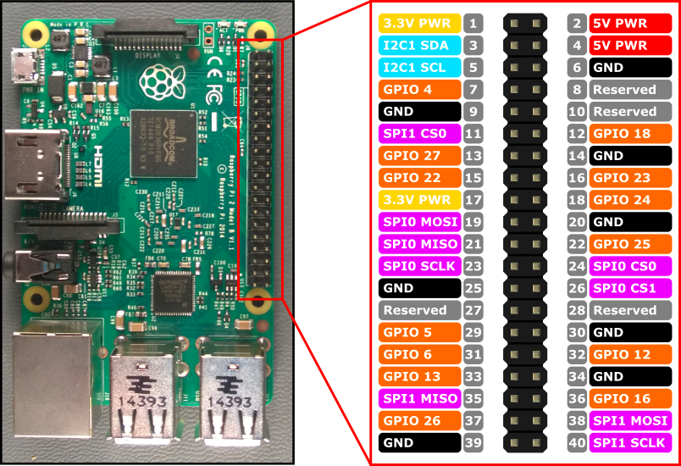
What is this GPIO thing?

Slide 18
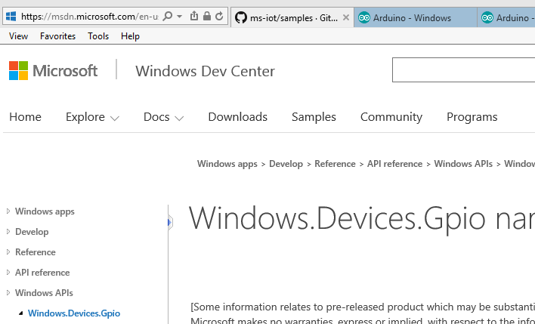
The API

Slide 19
Stop! PotPushBlinky time…

Slide 20
What the @#$%^!

Slide 21
What you are gonna need
Arduino UNO R3
SparkFun BlueSMiRF Gold
Arduino Development Environment
Breadboard and associated electronic bits
Lumia 520, Lumia 635, Lumina 640… <- huh?

Slide 22
Virtual Shield?
Accelerometer
Compass
Geolocator (GPS)
Gyrometer
Light Sensor
Orientation
Camera
Speech to Text and Speech Recognition
can receive table data from previous web search
Device info (name, date/time/timezone, os)
Email (initiation)
Microphone
Notifications (Tile/Toast)
Screen (Text, Images, Audio/Video, Rectangles, Buttons, Touchscreen)
Sms (initiation)
Web (Get and Post with result parsing)
Vibration

Slide 23
Stop! Arduino Time…

Slide 24
Links
That wifi dongle link: https://www.raspberrypi.org/products/usb-wifi-dongle/
https://dev.windows.com/en-us/iot
https://insider.windows.com/
https://ms-iot.github.io/content/en-US/win10/SetupRPI.htm
https://ms-iot.github.io/content/en-US/win10/samples/PowerShell.htm
https://www.hackster.io/

Slide 25
https://msdn.microsoft.com/en-us/library/windows/apps/xaml/windows.devices.gpio.aspx?f=255&MSPPError=-2147217396
http://www.arduino.cc/
https://www.sparkfun.com/products/12582
http://ms-iot.github.io/content/en-US/win10/SetupWVSA.htm
https://github.com/ms-iot/virtual-shields-arduino/

